Slide 1
Guess Game Featured by Nim Game
Presented by
Md. Al Amin Bhuiyan
Id: 1804084
Md Mehedi Hassan
Id:1804106
Md. Anamul Hasan Rony
Id: 1804118
Md. Naeem
Id: 1804120
Supervised by
Md. Mynul Hasan
Assistant Professor
Dept. of CSE(CUET)
Animesh Chandra Roy
Assistant Professor
Dept. of CSE(CUET)
Notes:
1
*

Slide 2
Contents
Introduction
Motivation
Application
Flow Chart
Function Description
Project Output
Conclusion

Slide 3
Introduction
A game of guessing the hidden numbers. There are two parts of the game:
Puzzle Game:
Puzzle game includes nine hidden buttons. The user has to find the targeted number from these buttons.
Nim Game:
The user has ten steps to find the hidden number. So the user has to search for the optimal number for each step.
Notes:
3

Slide 4
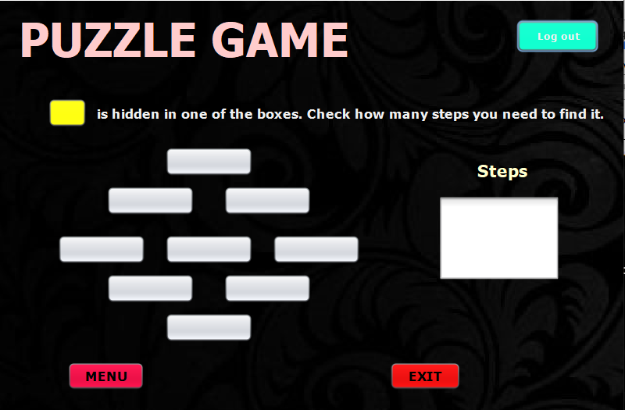
Puzzle Game

Slide 5
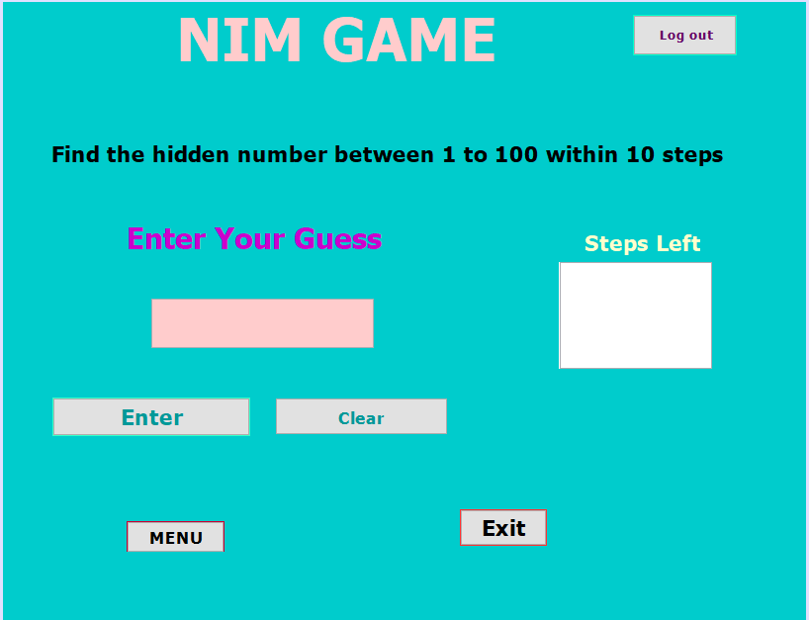
Nim Game

Slide 6
Motivation
Guess game sharpens the spatial visual intelligence.
This game will sharpens memory.
Puzzle Game sharpens the Little One's fine motor skills.
Nim Game trains eye and hand coordination.
Nim Game sharpens the ability to find solutions to problems.

Slide 7
Application
Puzzle game will help to increase guess power. It is full of suspense and uncertainty.
Nim game is created based on binary search. So in each step the player must choose the optimal answer otherwise the player might lost in the worst case

Slide 8
Flow Chart/Module
Creating UI for Guess Game
Programming the buttons, text box, menu bar, login and registration form
Programming the puzzle game
Programming the nim game
Programming the winner part, connecting every jframe

Slide 9
Function Description
We used Java swing to create the game. For the UI components we
used swing containers and swing control. For IDE we used NetBeans.
The functions we used are listed below:
Javax.swing.jFrame:
Jframe is class type of container. It works like the main window where the
swing containers and controls are added.
Javax.swing.JPanel:
Jpanel is a generic lightweight container. Jpanel is used here to enrich the
UI. The label is hence used on JPanel.
Javax.swing.JLabel:
Label is used to name the game here. We have used Guess Game,
Puzzle game, Nim Game etc as level here.
Javax.Swing.JComboBox:
Two combobox is used here for the game.
Jpassword:
It is used for taking password from user. It shows the text hidden with ‘*’.

Slide 10
Function Description
Javax.swing.JTextField:
JTextField is used to take input and show output. Here we have two JTextField. One textfield is editable and other is non editable. The editable textfield is for taking input. The non-editable textfield is for showing output.
Javax.swing.JButton:
We used buttons here. Clear button, Exit button, Guess button, Puzzle buttons and so on.
Javax.swing.JMenu jMenu:
This is used to make a menu system in the game to easily access every possible frame of the game.
JradioButton:
Allow user to select option.
JCheckBox:
Allow user to check required conditions such as on and off.
Jcalendar:
Used for taking date of birth.

Slide 11
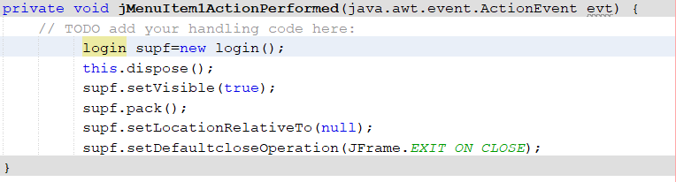
Action Perform
Connecting Jframes
Notes:
11

Slide 12
Action Perform
Exit Button:
Clear Button:
Notes:
12

Slide 13
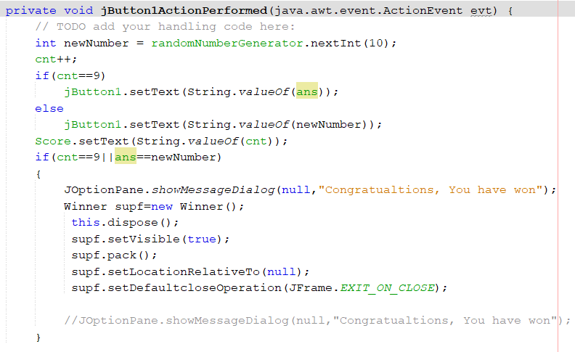
Puzzle Game
Resulting Part Code:
Notes:
13

Slide 14
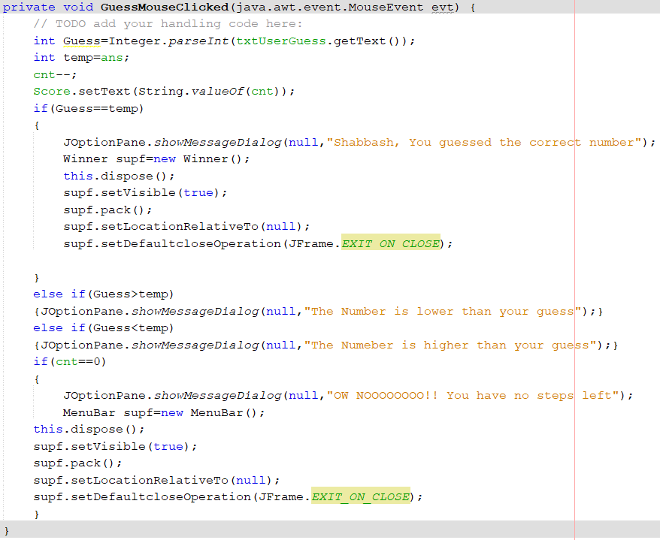
Nim Game
Resulting Part Code:
Notes:
14

Slide 15
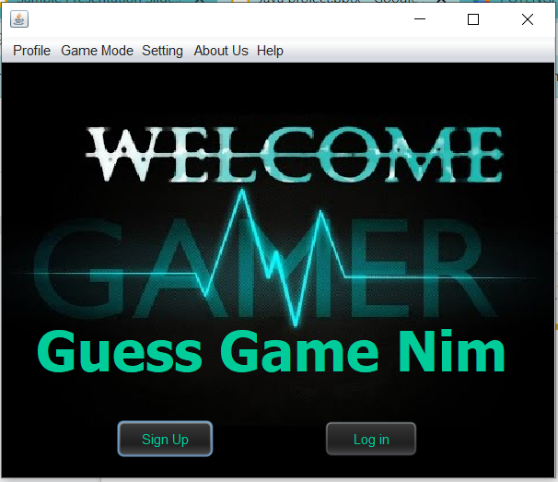
Project Output
Notes:
15

Slide 16
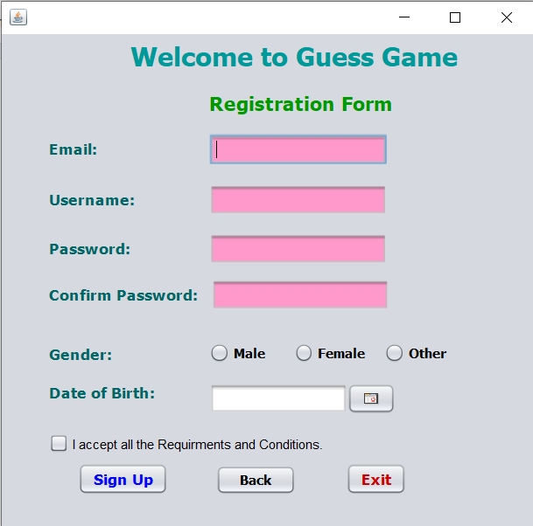
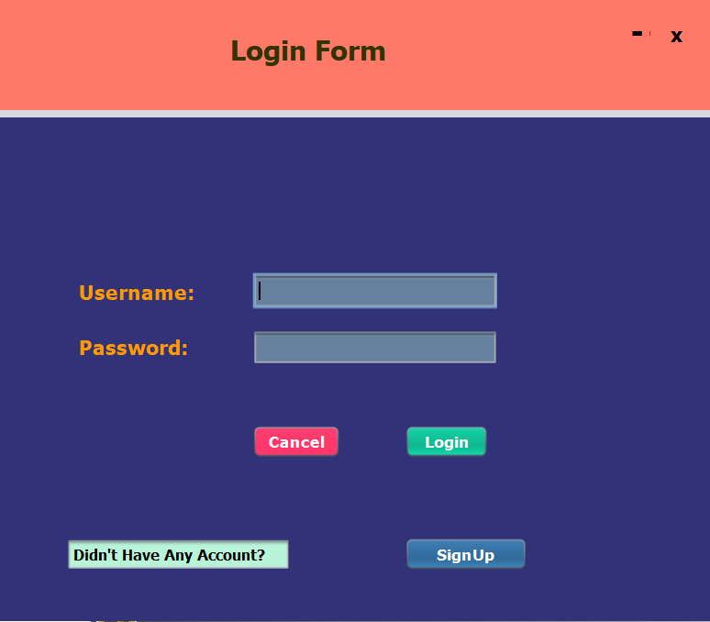
Project Output
Notes:
16

Slide 17
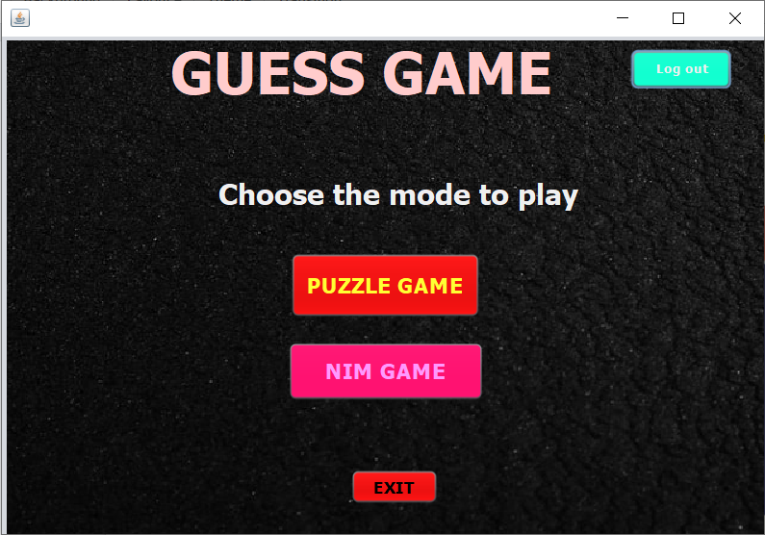
Project Output
Notes:
17

Slide 18
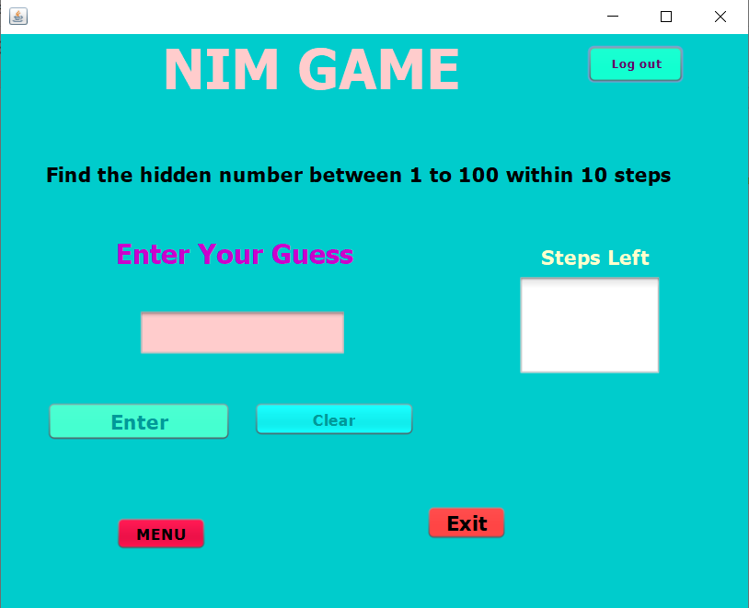
Project Output
Notes:
18

Slide 19

Project Output
Notes:
19

Slide 20
Conclusion
This game will improve the analytical skills of a player.
Our game will help to understand nim game and optimal way to take every steps.
The game is not only for entertainment purposes but also improves our guess and thinking capabilities.

Slide 21
Thank You All

